Slide 1

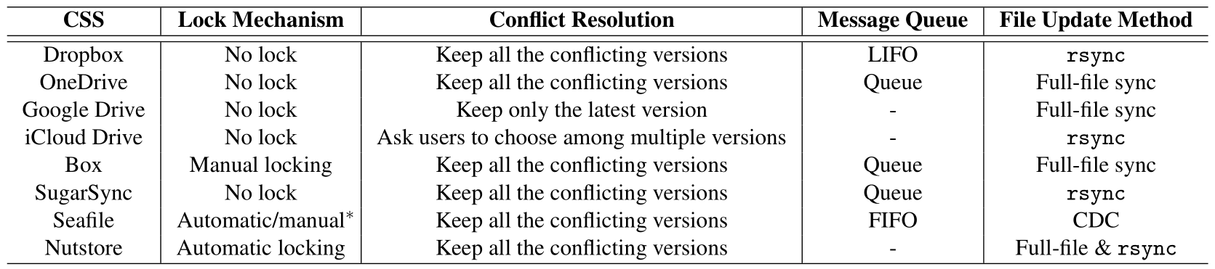
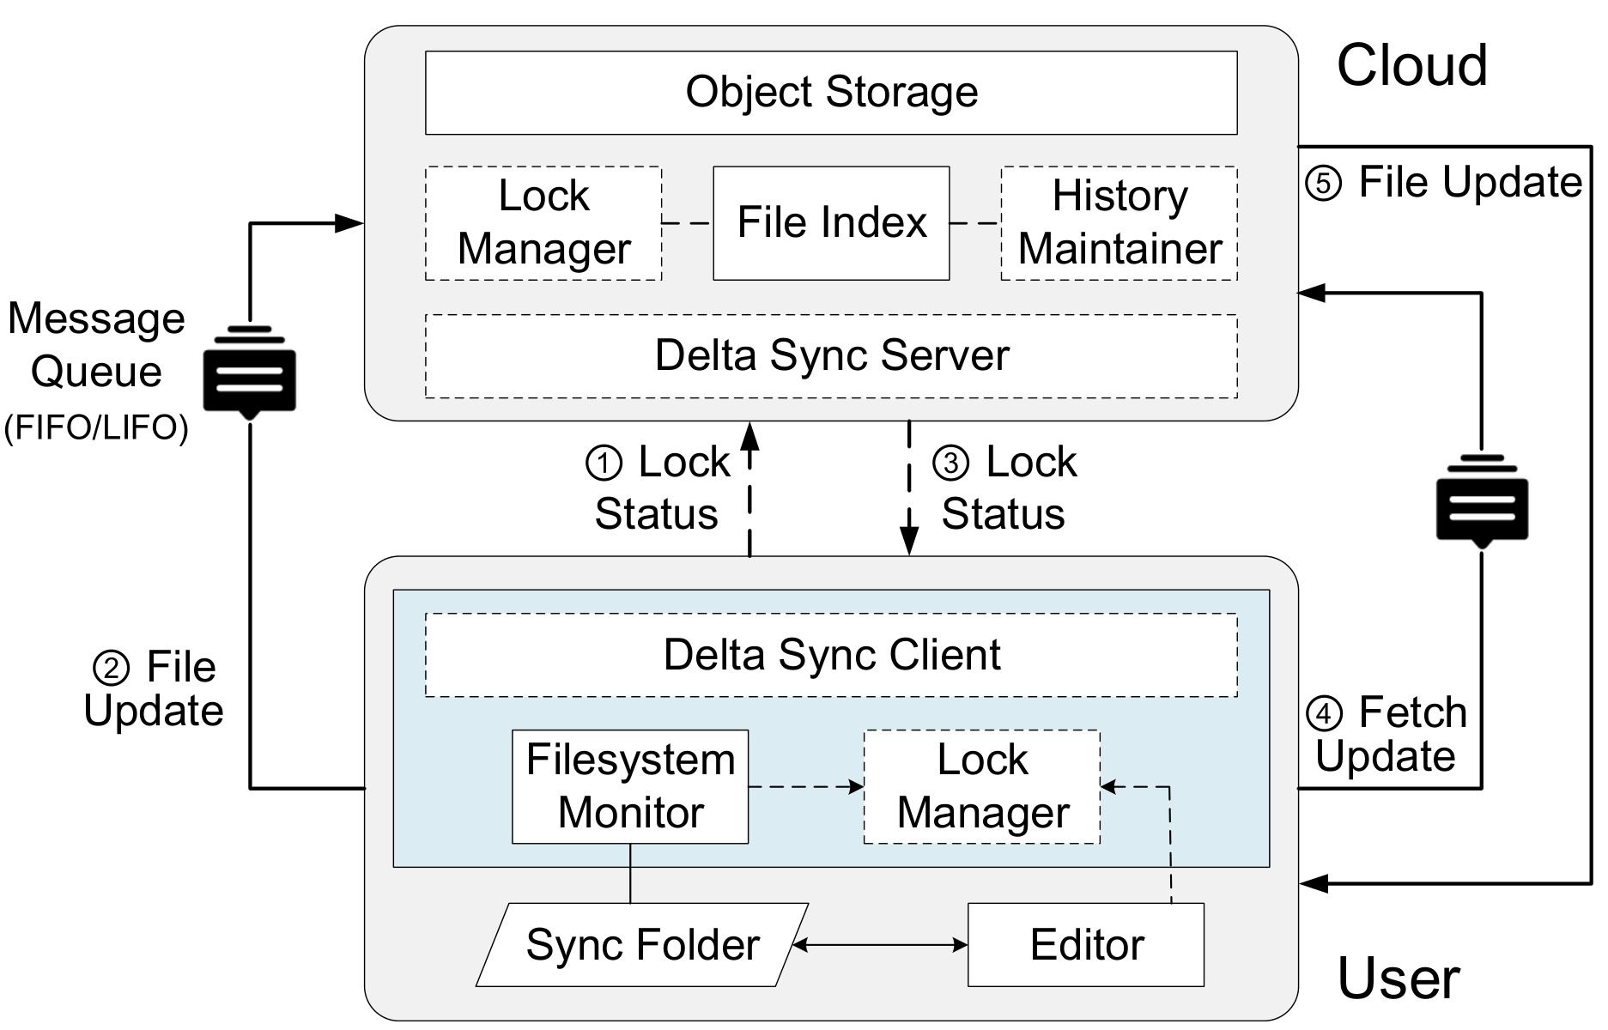
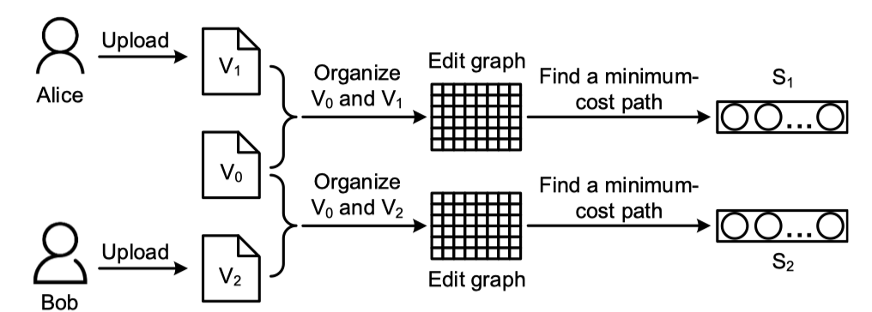
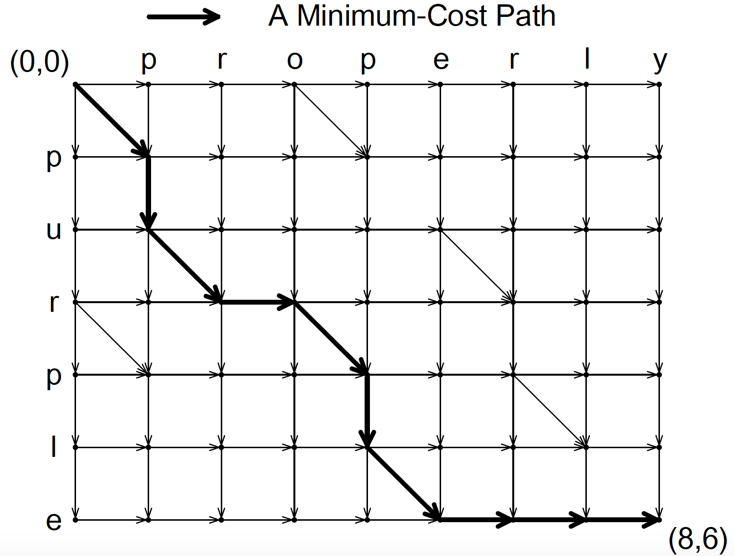
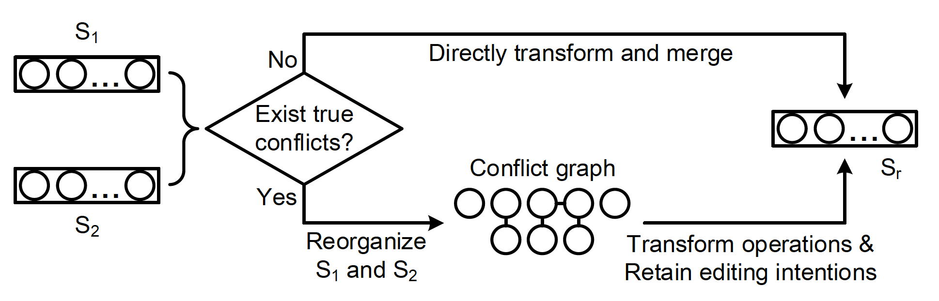
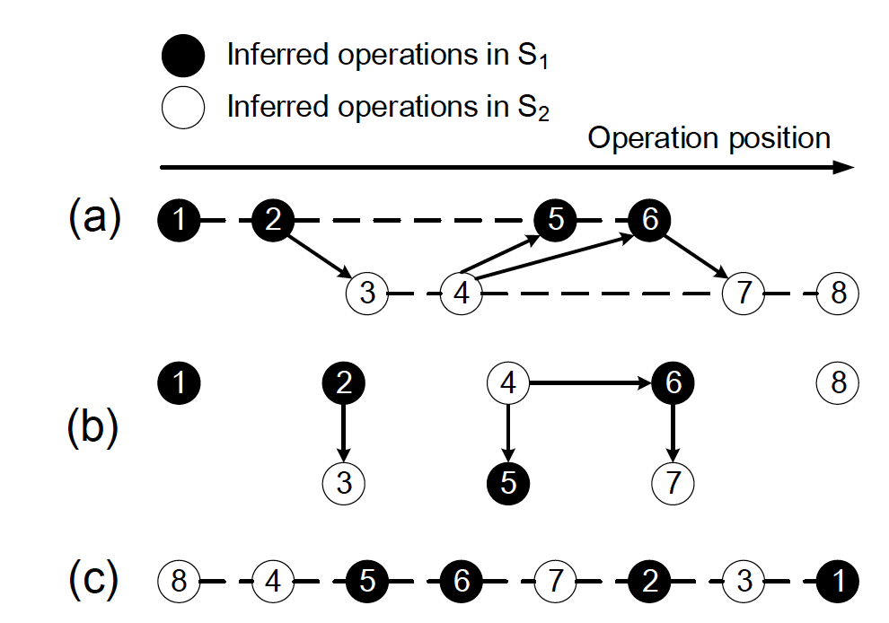
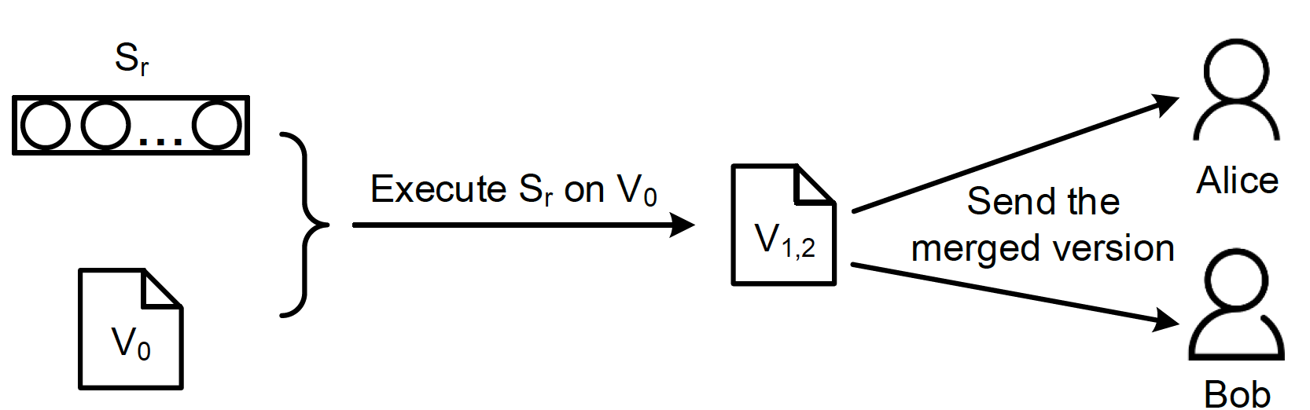
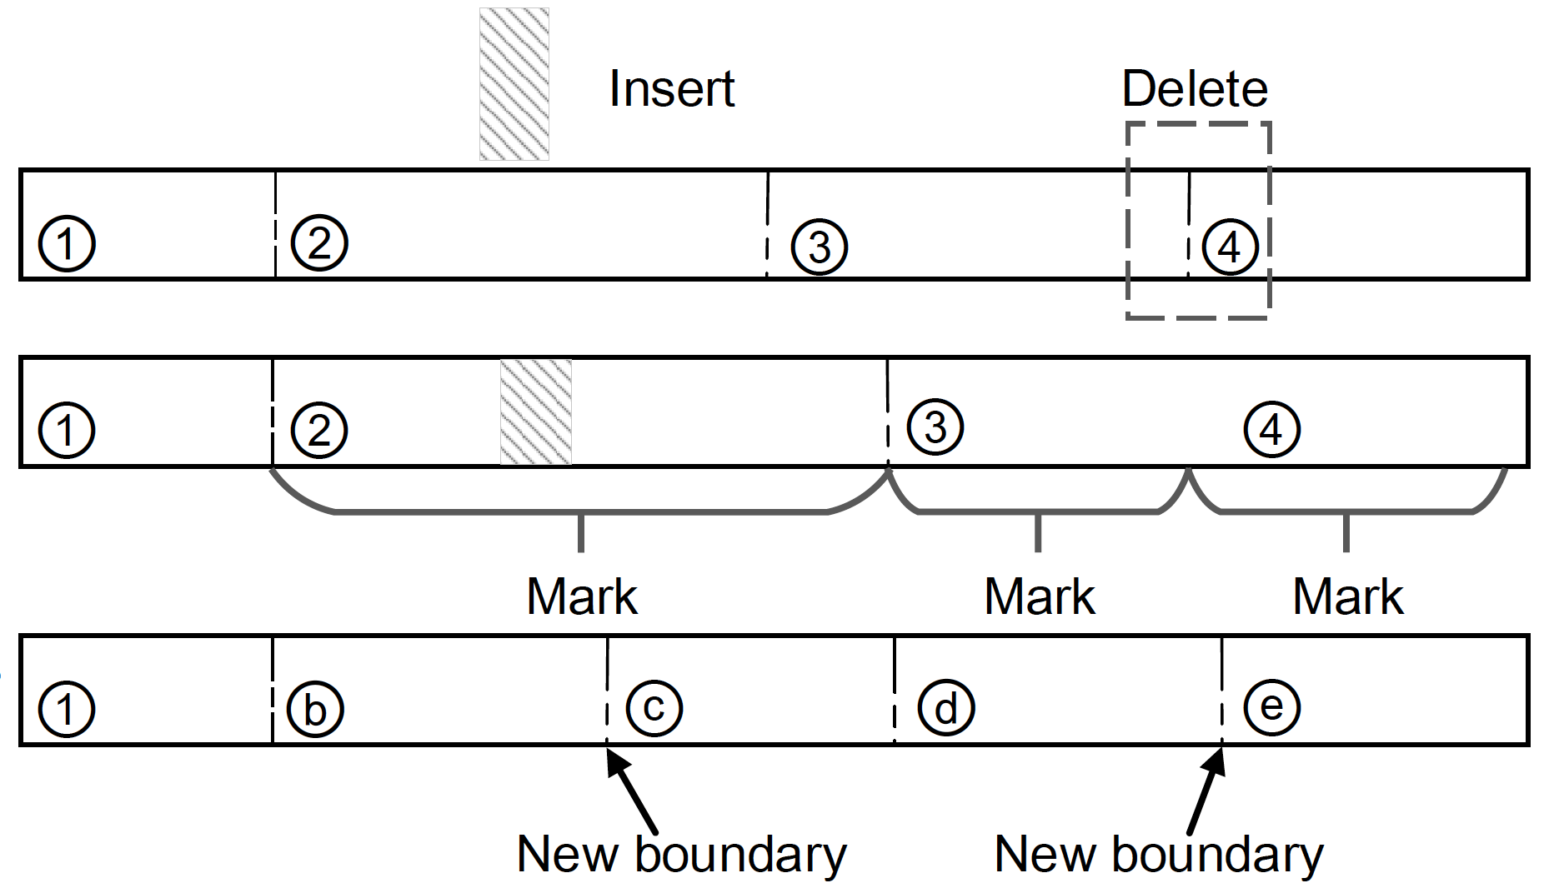
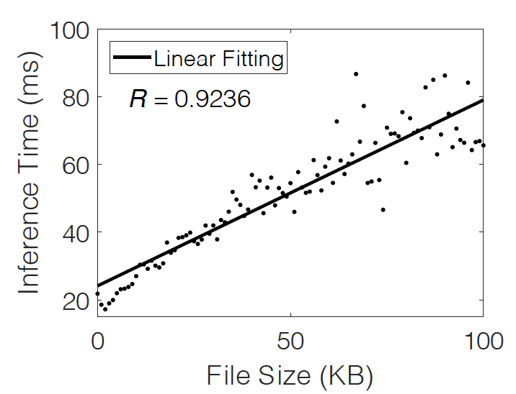
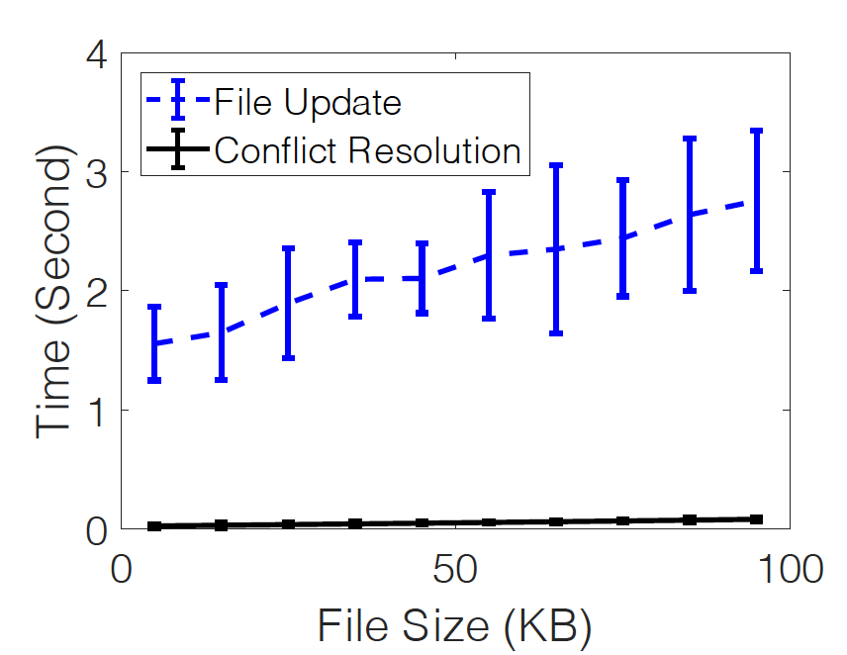
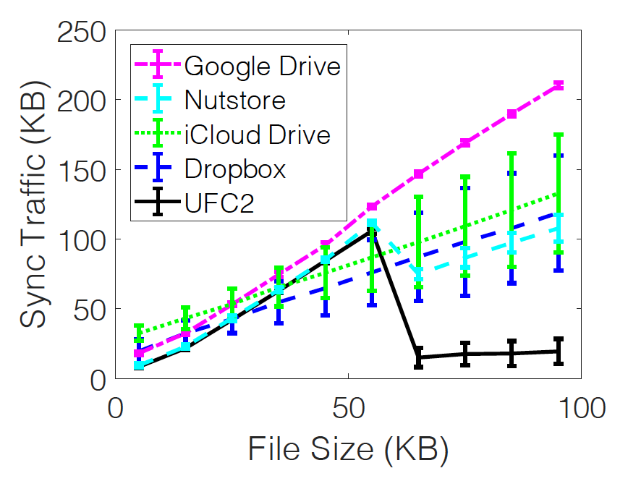
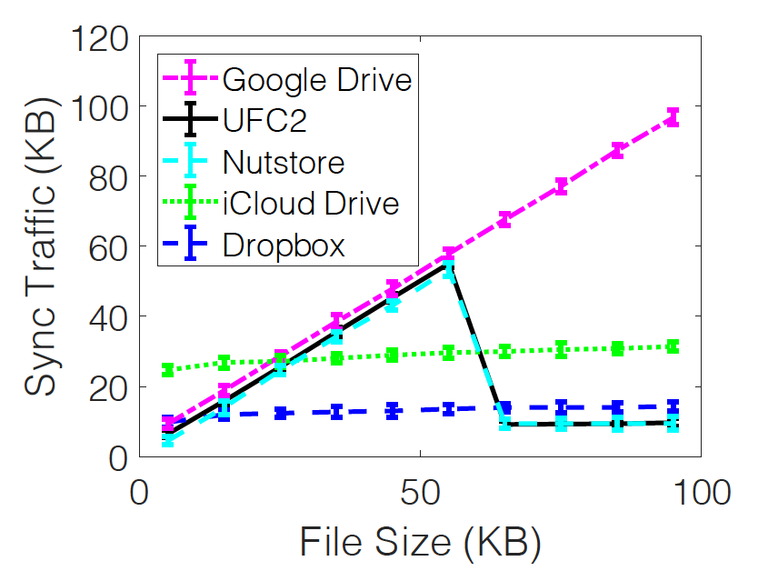
Lock-Free Collaboration Support for Cloud Storage Services with
Operation Inference and Transformation
Minghao Zhao, Jian Chen, and Zhenhua Li, Tsinghua University; Ennan Zhai, Alibaba Group; Feng Qian, University of Minnesota
Hongyi Chen Tsinghua University, Yunhao Liu, Tsinghua University and Michigan State University, Tianyin Xu, UIUC
Collaboration Support in Today’s Cloud Storage Services
Motivation:
Cloud storage services provide an easy-to-use and general way for collaborative file editing (compared with dedicated online editors like Google Docs and version control systems like Git and SVN), but their transparent solving of conflicts normally results in undesirable user experience. In this work, we aim at:
conducting measurement study to investigate the causes of poor experiences;
building practical system for better collaboration support.
Major Findings:
The occurrence probability of conflicts is about 4% in cloud storage services, and most of the conflicts are false conflicts (edits made on different parts of a file).
Long sync delay leads to conflicts and the adoption of message queue make it more severe
Ineffective conflict prevention method; it is unable to lock a file at an ideal time.
Unsatisfied conflict resolution strategies; file-level resolution are too coarse-grained
Implications:
Avoid using locks for conflict prevention
Fine-grained conflict resolution (i.e., automatic merging false conflicts)
Figure 1. Workflow and system components for supporting collaboration in mainstream cloud storage services.
UFC2: User-Friendly Collaborative Cloud
Key mechanism designs in UFC2
Inferring operations:
Finding the shortest operation sequence via Longest Common Substrings (LCS)
Efficient LCS calculation with edit graphs
(a) Inferring operation sequences of the uploaded versions using edit graphs.
Figure 3. Organizing words ”property” and “purple” with a conflict graph.
Handling true conflicts:
Reorder conflicting operations with a conflict graph
Topological sorting in the conflict graph
Merge the topological sorted operations with customized OTs and generate S_{r}
(b) Transforming and merging operation sequences with the minimal conflicts.
Figure 4. Organizing conflicting operations with conflict graphs
(c) Executing the merged operation sequence on the base version to generate a final merged version.
Figure 2. Working principle for merging two conflicting versions.
Figure 5. A demonstration of true conflicts detection.
Figure 6. Chunk-recalculation in OCDC.
Results
(a)
(b)
(a)
(b)
Figure 7. Time overhead in operation inference (a) and conflict resolution (b).
Figure 8. Traffic overhead when there are (a) and there are no (b) true conflicts.

